Slide 1
MODELING DATA USING SIMPLE GRAPHS
Building Intuition About Machine Learning
Steve Aronson

Slide 2
Create visual models
Find visual patterns that identify groupings in our data
Machine learning does this, but with a lot more math, statistics, and programming
Build three predictors from existing data
Estimating car mpg from specifications – tabular
Identify handwritten digits – image
Identify similar questions from an online forum – text
Basic framework
Collect some data
Convert the data into a format suitable for machine learning
Look for useful patterns in the data
Use these patterns to predict new results

Slide 3
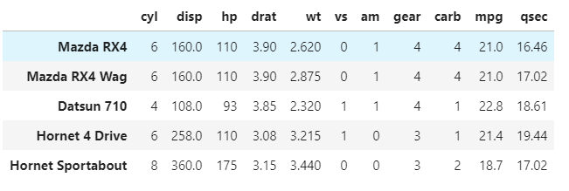
Estimating car mpg
Collect some car data
Simple tabular data set – very common
Characteristics about cars
Each row describes a car
9 features that describe the car
2 results of performance
Goal is to estimate mpg for new design
FEATURES
RESULTS

Slide 4
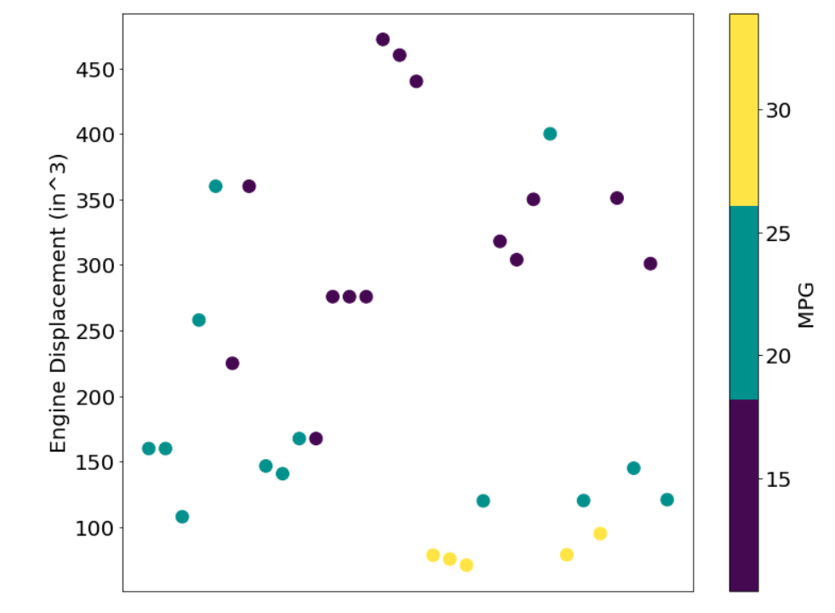
Build a model to predict MPG
Put cars into horizontal bands that group mpg
Simple one variable
Pick one factor and see if it correlates with desired output
Plot engine size (y-axis) and color by mpg
Get some separation, but still overlap

Slide 5
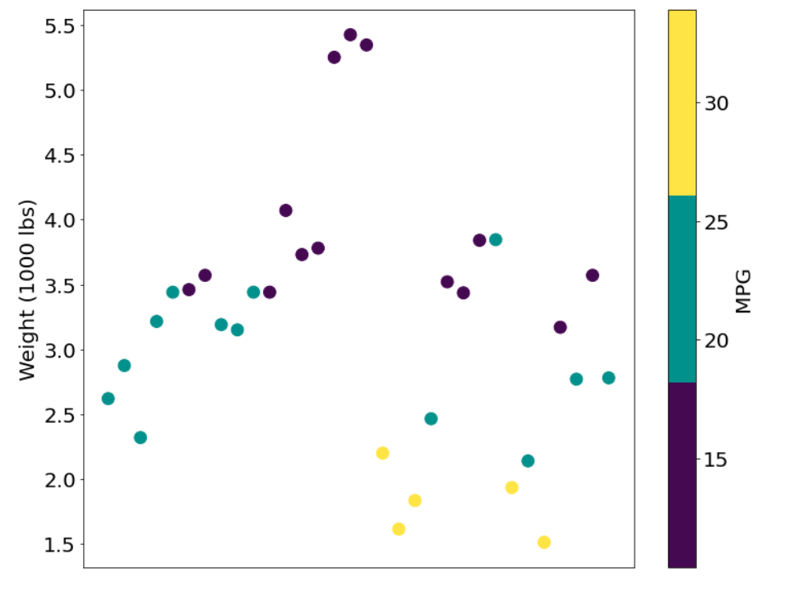
Build a model to predict MPG
Simple another variable
Plot vehicle weight (wt) and color by mpg
Similar results

Slide 6
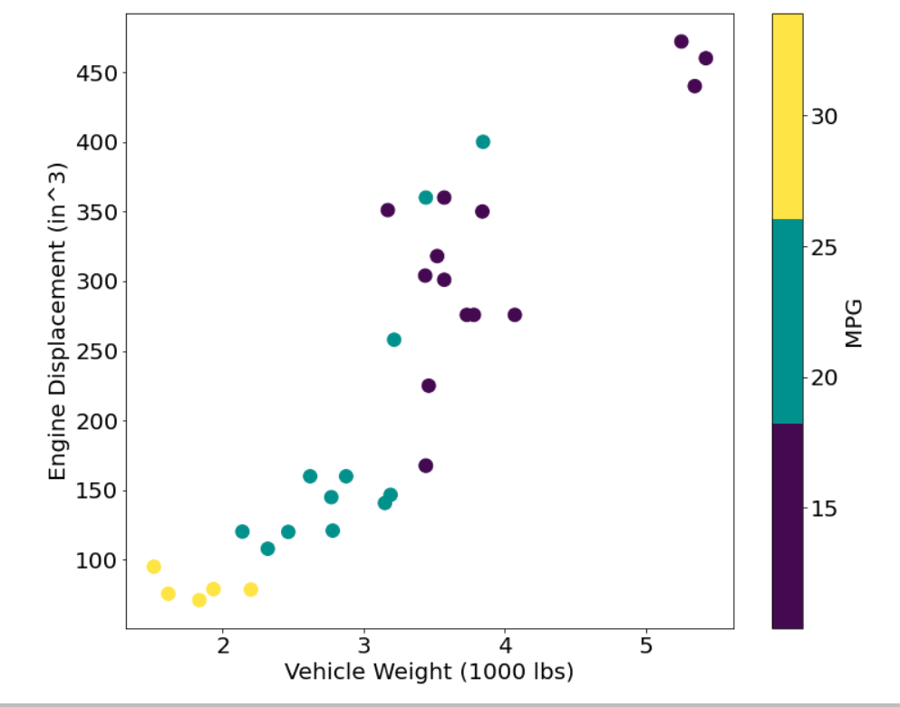

Build a model to predict MPG
Use 2 factors
Plot engine displacement (y-axis) vs. vehicle weight (x-axis) and color by mpg
Get pretty good separation
Use this with new designs to estimate MPG

Slide 7
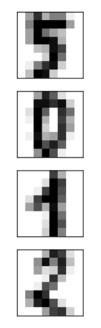
Identifying handwritten digits
Collect some images that already have labels
Use this data to build our model
Goal is to label new images
5
0
1
2

Slide 8
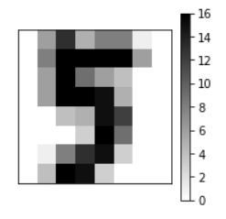
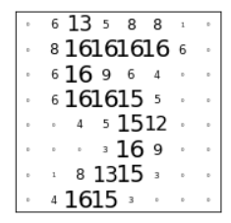
Converting images into inputs
8
Images are made up of pixel values
Value is how dark that pixel is
Read pixel values left to right, top to bottom to obtain input
Image is 8x8, so input is 64-dimensions
Similar images will have similar inputs
8
1x64

Slide 9

Finding 2 dimensions for our model
Like the car data, looking for a simple 2 factor model that separates the images
Unlikely that selecting 2 will be successful
Attempt to smash (project) 64-dimension space down to 2-dimensions
Like looking at the shadow of an airplane overhead

Slide 10




Projecting
Side View
Front View
Top View

Slide 11
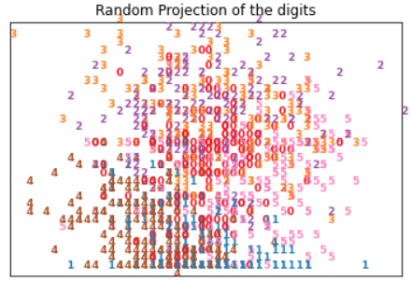
Apply projections to the images of digits
Random
Select 2 (of 64) dimensions
As expected, not successful in creating seperation

Slide 12
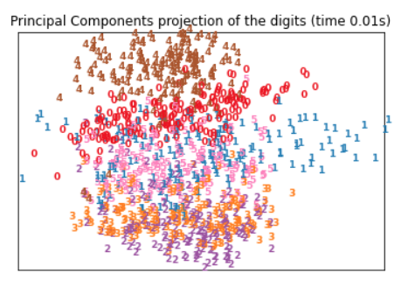
Apply projections to the images of digits
Principal Component
Find 2 dimensions that spread the data the most
Start to see some banding

Slide 13
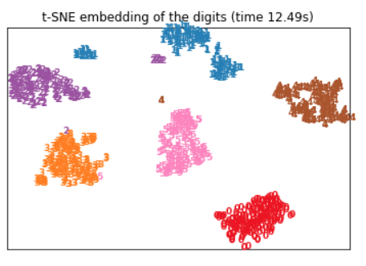

Apply projections to the images of digits
Distance between points (t-SNE)
Map distances from point to point in original space to 2 dimensions
Easily identify inputs that are like each other
Predicting new image
Convert image to input array
Apply same mapping
See which grouping is closest

Slide 14
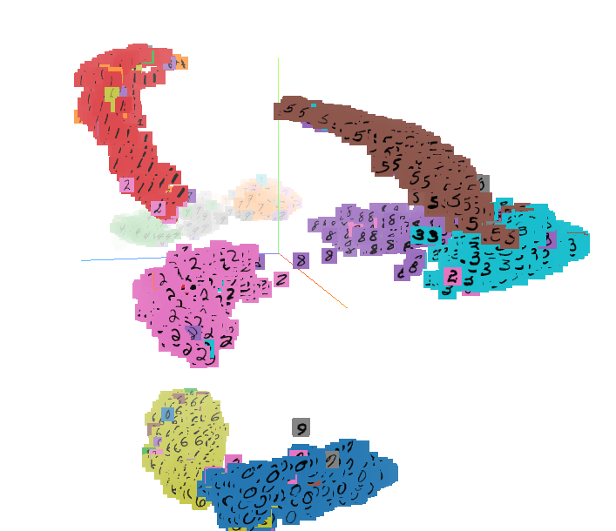
Can also project into 3d
Tool published by Google’s TensorFlow
3D projection of the larger MNIST dataset
EMBEDDING PROJECTOR
https://projector.tensorflow.org/

Slide 15
Identifying similar questions
Collect some data
This data set comes from Quora
Start with a set of questions that have duplicates labeled
Simple idea count matching words
Lacks matching words with similar meanings (gods/mythology)
Build a model that can identify similar words
Count word matches that are identical or similar
Use this model to estimate similarity of new questions
Question 1 | Question 2 | Duplicate?
Does anyone see the relation between Greek gods and Hindu gods? | What parallelism can we draw between gods of Hindu mythology, Greek mythology, Egyptian mythology, etc.? | Yes
How much is 30 kV in HP? | Where can I find a conversion chart for CC to horsepower? | No

Slide 16
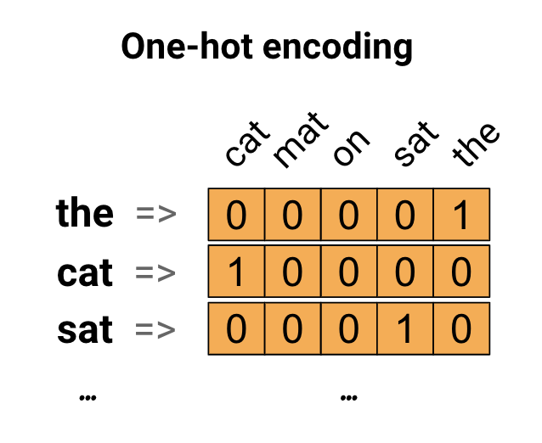
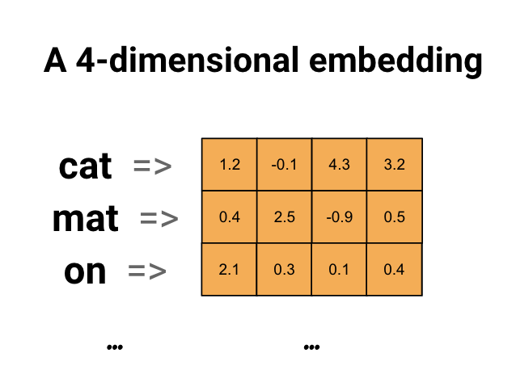
Convert words to inputs
The cat sat on the mat
Converting text (or words) into input is called embedding
Introduce two techniques using a simple sentence
One-hot encoding (top image)
Works, but doesn’t capture similarity in words
Dimensional embedding (bottom image)
Uses a machine learning model – word2vec
Better method for building similarity between words

Slide 17
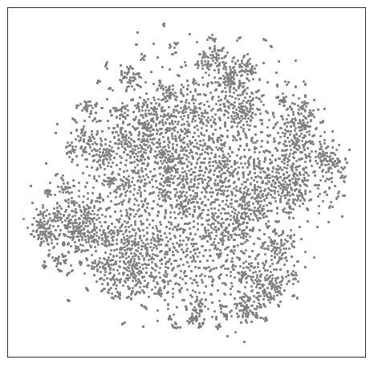
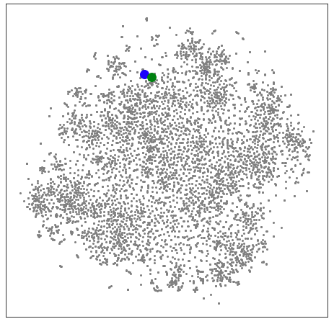
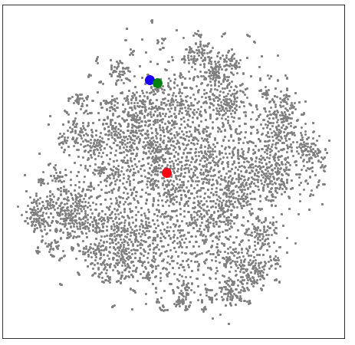
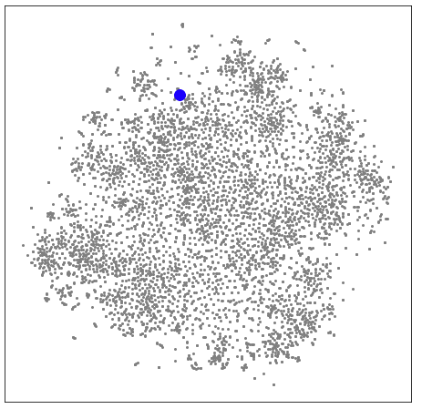
Projecting words
Question 1 | Question 2 | Duplicate?
Does anyone see the relation between Greek gods and Hindu gods? | What parallelism can we draw between gods of Hindu mythology, Greek mythology, Egyptian mythology, etc.? | Yes
How much is 30 kV in HP? | Where can I find a conversion chart for CC to horsepower? | No
Map all our words in 2D
Located mythology on our map
By adding gods, we can see how close these words appear
Horsepower maps much farther away
Our model is working
The distance between word embeddings represents the similarity between the words

Slide 18
Summary
Demonstrated a simple learning flow
Collected data for our model
Converted the data into a suitable form (usually arrays)
Mapped high dimensional data to 2D
Used the patterns to make predictions
Take always
Build intuitive sense of how machine learning works
Introduce visualization techniques that help explain how models work

